Slide 1
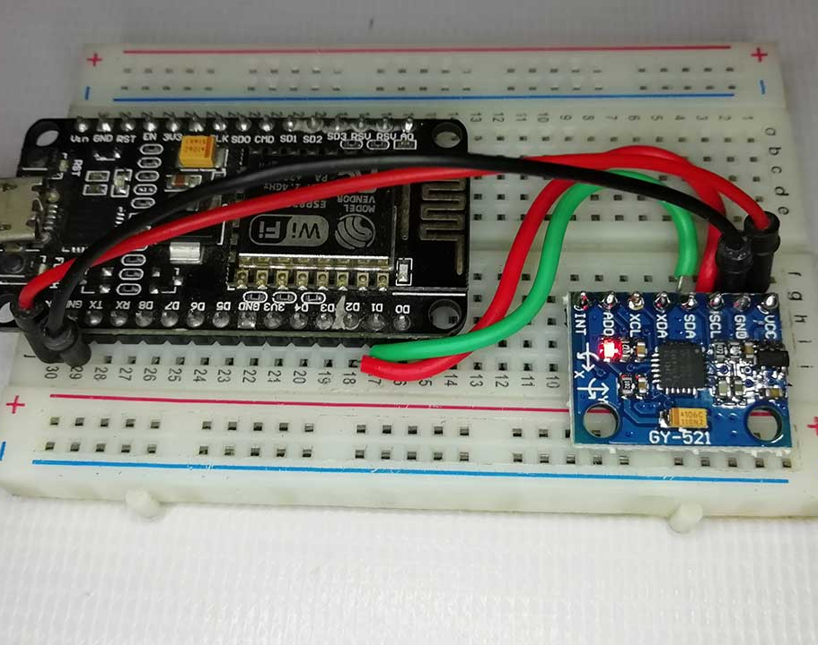
IoT BASED-FALL DETECTION SYSTEM USING NODE MCU ESP 8266 & MPU 6050
Presented by :
Achyuth Mukund – 22011102005
Darshan. S – 22011102014
3. Kavin. V - 22011102041
Project Guide – Dr. S. Vidhusha

Slide 2
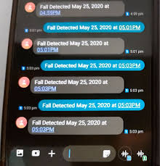
Introduction
Every second counts in healthcare and elderly care and fall detection can mean the difference between life and death. It's the silent guardian that ensures our loved ones are never truly alone, offering a lifeline when they need it most.
Fall detection in healthcare is a critical component of patient safety and well-being. This feature has gained increasing importance in recent years, as it addresses a significant concern for both healthcare providers and patients.
In this presentation, we will explore the key reasons why fall detection plays a pivotal role in healthcare and how it can make a positive impact on patient outcomes and healthcare institutions.

Slide 3
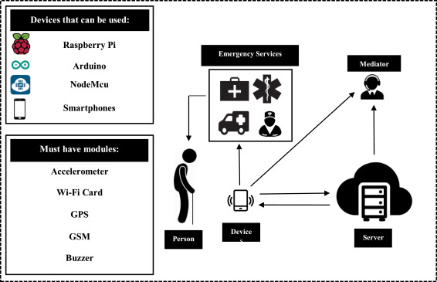

Slide 4
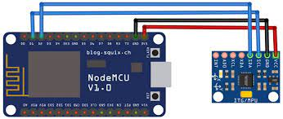


Circuit Diagram :
This circuit diagram illustrates the connections between a Node MCU ESP8266 development board and an MPU-6050 sensor module.
The Node MCU ESP8266 is used for data processing and communication, while the MPU-6050 sensor measures motion and orientation.

Slide 5
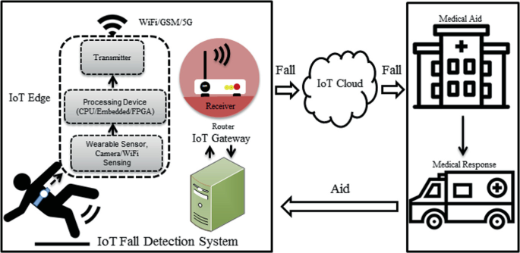
How the system works :
1. Sensor Data Acquisition
2. Data Processing
3. Fall Detection Algorithm
4. Alert Generation
5. Emergency Response
6. Data Logging and Analysis
The MPU-6050 sensor constantly collects data on acceleration and angular velocity in all three axes (X, Y, Z).
Node MCU ESP8266 processes the incoming sensor data in real-time, using programmed algorithms to detect significant changes in motion and orientation that may indicate a fall.
The system employs a fall detection algorithm that takes into account the rate of change of acceleration and the orientation of the device. Sudden, abnormal changes trigger a fall alert.
When a potential fall is detected, Node MCU triggers an alert. It can send alerts in various ways, such as through Wi-Fi, SMS, email, or integration with other IoT devices or healthcare systems.
Depending on the setup, the system can be configured to send alerts to caregivers, family members, or healthcare professionals. It ensures a prompt response to the fall event.

Slide 6

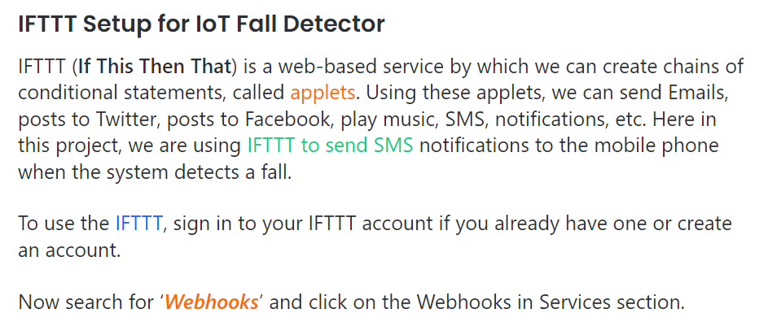
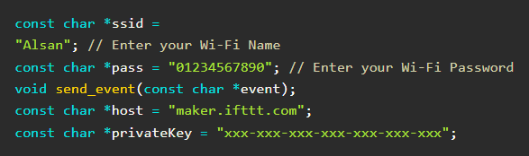

Slide 7
CONCLUSION & FUTURE SCOPE
In conclusion, the IoT-based fall detection system using Node MCU ESP8266 and the MPU-6050 sensor represents a significant advancement in healthcare and assisted living technology.
This system addresses a critical need for rapid response to fall incidents, enhancing the safety and well-being of individuals, particularly in healthcare settings and among the elderly.
As technology continues to advance, the IoT-based fall detection system serves as a testament to innovation's potential in enhancing healthcare, ensuring the safety of vulnerable populations, and contributing to a more connected and caring world.
This project not only represents the present state of technology but also paves the way for future advancements in healthcare and IoT applications, making a positive impact on people's lives.
Integration with Healthcare Systems
Machine Learning and AI
Real-Time Location Tracking
Environmental Sensors
Advanced Analytics
Voice Recognition and Assistance
Emergency Services Integration
Wearable Devices
Remote Monitoring
Smart Home Integration

